Slide 1




Slide 2

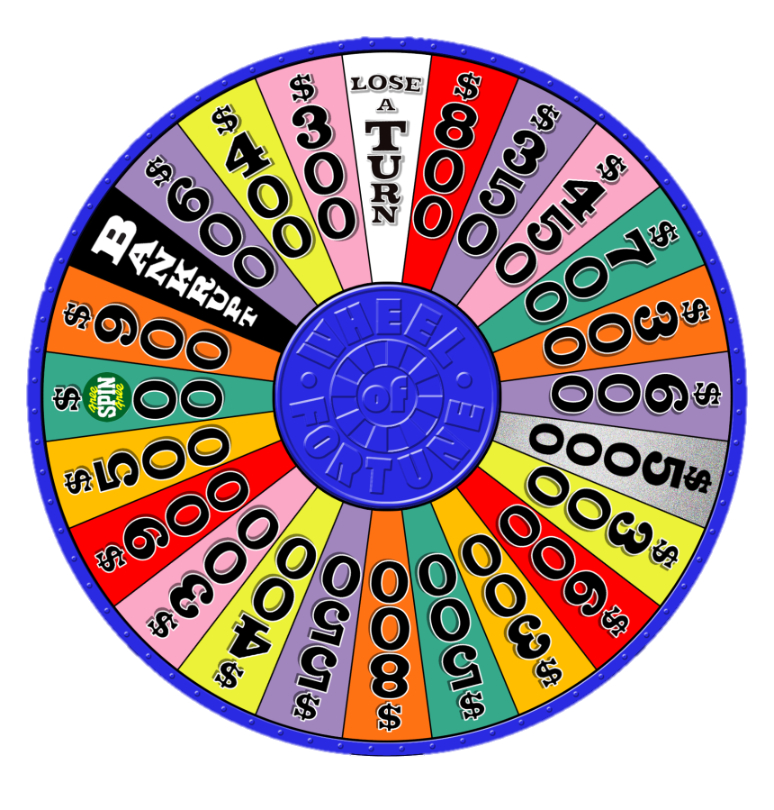
SPIN
STOP

Slide 3
SPIN
STOP

Slide 4
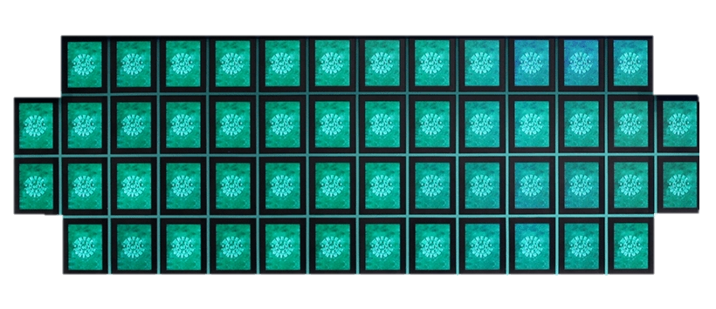
-
G
O
D
I
S
G
O
O
D
WHEEL OF FORTUNE (CLAFLIN EDITION)

Slide 5

THANK YOU FOR PLAYING!

